Slide 1


Sanction Screening
Of Payments Transactions
Group Members
Gargi Joshi
Rutuja Ghorpade
Shivani Mohankumar
Yamini Dongaonkar
Mansi Indore
Group No: 1
Group Mentor
Harsh Singhal

Slide 2
What is Sanction screening?
Features
AGENDA
Technology Stack
Data flow diagram
Demo
Journey through the program

Slide 3
WHAT IS SANCTION SCREENING?
A Sanction Screening is a combination of policies, procedures and technologies that enable a financial institution to ensure that it does not provide any form of services to sanctioned parties, directly or indirectly.

Slide 4


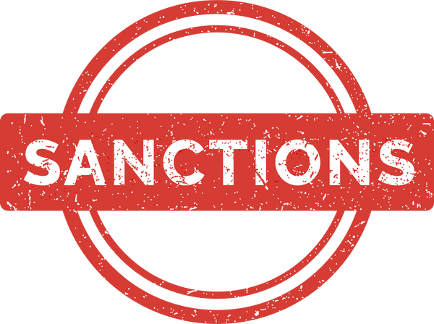







FEATURES:
Login Page
Upload File
Validation
Sanctioning
Display
sanctions
Filtering
Archives
Report

Slide 5






TECHNOLOGY STACK:

Slide 6
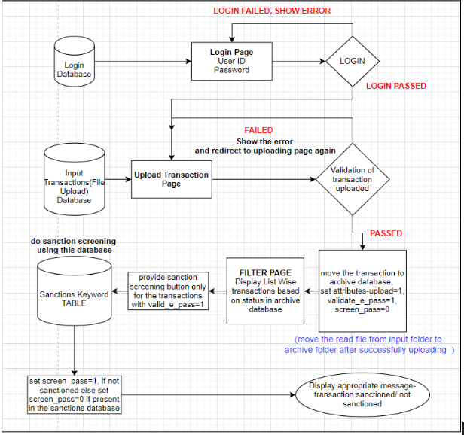
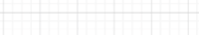
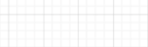
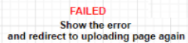
DATA FLOW

Slide 7
DEMO

Slide 8
FUTURE SCOPE:
Admin rights
Daily report generation
Failure to deliver
Encrypted system

Slide 9

CHALLENGES FACED
Different tech stack
Collaborating with new team
Time management
Conflicting point of view

Slide 10
JOURNEY THROUGH THE
PROGRAM

Slide 11
THANK YOU
ANY QUESTIONS?

